Slide 1
CS 4530
Software Engineering
Lecture 14 - Analysis/Refactoring; Covey.Town Internals
Jonathan Bell, John Boyland, Mitch Wand
Khoury College of Computer Sciences

Slide 2

Zoom Mechanics
Recording: This meeting is being recorded
If you feel comfortable having your camera on, please do so! If not: a photo?
I can see the zoom chat while lecturing, slack while you’re in breakout rooms
If you have a question or comment, please either:
“Raise hand” - I will call on you
Write “Q: <my question>” in chat - I will answer your question, and might mention your name and ask you a follow-up to make sure your question is addressed
Write “SQ: <my question>” in chat - I will answer your question, and not mention your name or expect you to respond verbally

Slide 3
Today’s Agenda
Administrative:
Project Plan due tomorrow!
HW4 due next Friday
Today’s session:
Static analysis + refactoring review + discussion
Notes:
Reminders of async/await gotchas, expecting an exception, hard-coding error message in that too

Slide 4
Static Analysis Review
Find likely bugs, but programming practices (eslint + LGTM/codeql)
Extremely difficult to prove that programs are correct
This is an enormous research area

Slide 5
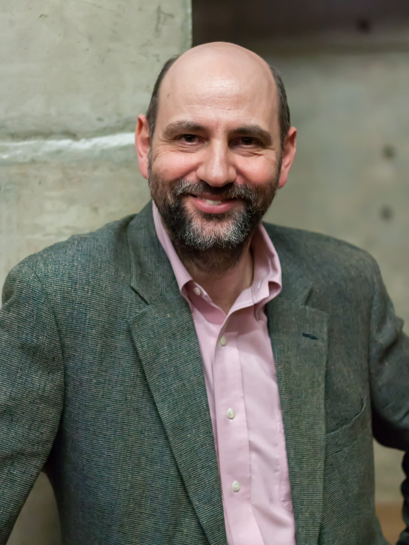
Refactoring
Martin Fowler
“Any fool can write code that a computer can understand. Good programmers write code that humans can understand.”
Notes:
Author of many works on software engineering methodology, including the seminal text on refactoring. Not inventor of refactoring by any means, but an evangelist for refactoring and related development methodologies

Slide 6
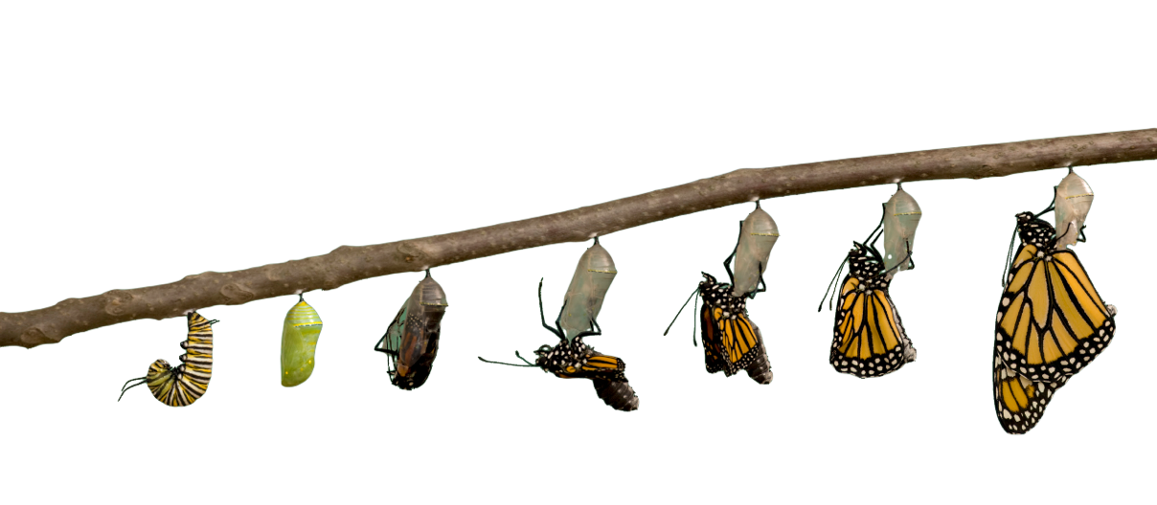
Why Refactor?
requirements have changed, and a different design is needed
design needs to be more flexible (so new features can be added)
design patterns are often a target for refactoring
address sloppiness by programmers
Notes:
Characteristics that might be improved: Maintainability: Easier to read and understand, Easier to (further) modify, Easier to integrate, Easier to test

Slide 7
Example Refactoring
Consolidating duplicate conditional fragments
Original Code
Refactored Code
if (isSpecialDeal()) {
total = price * 0.95;
send()
} else {
total = price * 0.98;
send()
}
if (isSpecialDeal()) {
total = price * 0.95;
} else {
total = price * 0.98;
}
send()

Slide 8
Observations
small incremental steps that preserve program behavior
most steps are so simple that they can be automated
automation limited in complex cases
refactoring does not always proceed “in a straight line”
sometimes, undo a step you did earlier…
…when you have insights for a better design
Notes:
A disciplined technique for restructuring an existing body of code, altering its internal structure without changing its external behavior
Series of small behavior-preserving transformations
Each transformation does little, but a sequence of transformations can produce a significant restructuring
Since each refactoring is small, it's less likely to go wrong
The system is also kept fully working after each small refactoring (via regression testing), reducing the chances that a system can get seriously broken during the restructuring

Slide 9
When to refactor?
Refactoring is incremental redesign
Acknowledge that it will be difficult to get design right the first time
When adding new functionality, fixing a bug, doing code review, or any time
Refactoring evolves design in increments
Refactoring reduces technical debt
What do you refactor?
Notes:
When you add new functionality
Do it before you add the new function, to make it easier to add the function
Or do it after you add the function, to clean up the code including that function
When you need to fix a bug
As you do a code review
Whenever…
The idea behind refactoring is to acknowledge that it will be difficult to get a design right the first time
And as a program’s requirements change, the design may need to change
It is notoriously difficult (impossible?) to design for all possible changes a priori
And as agile programming proponents say, “You aren’t gonna need it” – but what if later you do?
Refactoring provides techniques for evolving the design in small incremental steps
Technical debt: The project’s requirements are constantly changing and at some point it may become obvious that parts of the code are obsolete, have become cumbersome, and must be redesigned to meet new requirements. On the other hand, the project’s programmers are writing new code every day that works with the obsolete parts. Therefore, the longer refactoring is delayed, the more dependent code will have to be reworked in the future.

Slide 10
Code Smells
Mysterious Name
“We may fantasize about being International Men of Mystery, but our code needs to be mundane and clear”
- Martin Fowler on “Mysterious Name”
“Refactoring: Improving the Design of Existing Code,” Martin Fowler, 1992
Notes:
Sadly, however, naming is one of the two hardest things in programming. So, perhaps the most common refactorings we do are the renames: Change Function Declaration (124) (to rename a function), Rename Variable (137), and Rename Field (244). People are often afraid to rename things, thinking it’s not worth the trouble, but a good name can save hours of puzzled incomprehension in the future.
Renaming is not just an exercise in changing names. When you can’t think of a good name for something, it’s often a sign of a deeper design malaise. Puzzling over a tricky name has often led us to significant simplifications to our code.

Slide 11
Code Smells
Shotgun Surgery
“When the changes are all over the place, they are hard to find, and it’s easy to miss an important change.”
- Martin Fowler on “Shotgun Surgery”
“Refactoring: Improving the Design of Existing Code,” Martin Fowler, 1992
Notes:
Shotgun surgery is similar to divergent change but is the opposite. You whiff this when, every time you make a change, you have to make a lot of little edits to a lot of different classes.

Slide 12
Code Smells
A complete list (links to book!)
Mysterious Name
Duplicated Code
Long Function
Long Parameter List
Global Data
Mutable Data
Divergent Change
Shotgun Surgery
Feature Envy
Data Clumps
Primitive Obsession
Repeated Switches
Loops
Lazy Element
Speculative Generality
Temporary Field
Message Chains
Middle Man
Insider Trading
Large Class
Alternative Classes with Different Interfaces
Data Class
Refused Bequest
“Refactoring: Improving the Design of Existing Code,” Martin Fowler, 1992

Slide 13
“Local” Refactorings
Rename | rename variables, fields methods, classes, packages provide better intuition for the renamed element’s purpose
Extract Method | extract statements into a new method enables reuse; avoid cut-and-paste programming improve readability
Inline Method | replace a method call with the method’s body often useful as intermediate step
Extract Local | introduce a new local variable for a designated expression
Inline Local | replace a local variable with the expression that defines its value
Change Method Signature | reorder a method’s parameters
Encapsulate Field | introduce getter/setter methods
Convert Local Variable to Field | convert local variable to field sometimes useful to enable application of Extract Method
Notes:
some examples of widely used refactorings that are “local” in scope
useful for restructuring methods
We already talked about bad names and duplicate code. We would fix these smells by applying refactoring rename and extract method, resp
Inline method is inverse: when you want to go fold a method back into another
Extract local variable is like extract method, but what you might do with just an expression, so that a big expression can be more manageable
Again, inline local is the inverse: eliminating a local variable that is maybe superfluous
Change function declaration lets us adapt the order of parameters on a method
encapsulate a field replaces direct field accesses with getters/setters, and
Convert local to field creates a field with the specified scope to replace a local variable.
These are just a few of the hundreds of refactorings in Fowler’s book

Slide 14
Type-Related Refactorings
Generalize Declared Type | replace the type of a declaration with a more general type
Extract Interface | create a new interface, and update declarations to use it where possible
Pull Up Members | move methods and fields to a superclass
Infer Generic Type Arguments | infer type arguments for “raw” uses of generic types
Notes:
refactorings for changing the class hierarchy and/or the types of declarations of variables and fields
purpose is to make designs more flexible, e.g., by facilitating the introduction of design patterns
Way, way more refactoring than this. Again, over a hundred. What’s most useful is often what’s automated…

Slide 15
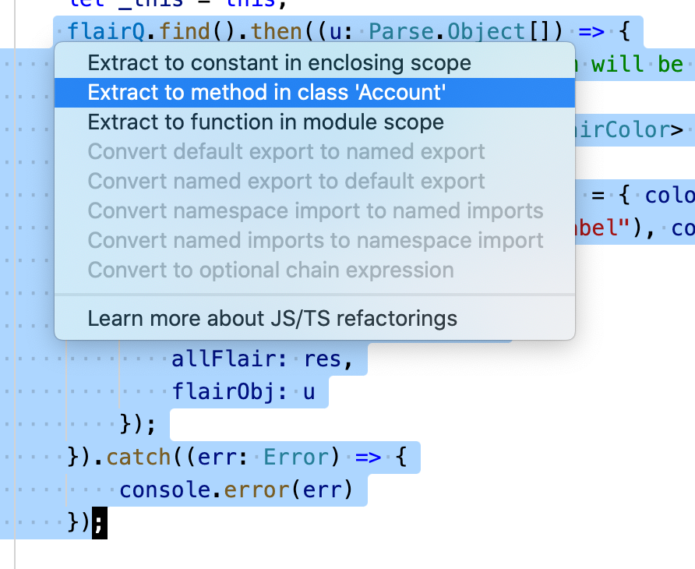
Automated Refactorings in VSC

Slide 16
Refactoring Risks
Developer time is valuable: is this the best use of time today?
Despite best intentions, may not be safe
Potential for version control conflicts
Notes:
If programmers spend time “cleaning up the code”, then that’s less time spent implementing required functionality - and the schedule is slipping as it is!
Refactoring can break code that previously worked
Refactoring needs to be systematic, incremental, and safe

Slide 17
Technical Debt
Life span and the importance of upgrades
Figures: “Software Engineering at Google: Lessons Learned from Programming Over Time,” Wright, Winters and Manshreck, 2020 (O’Reilly)
Notes:
If new OS, new version of Python, new Twilio library, whatever comes out, should we upgrade?

Slide 18
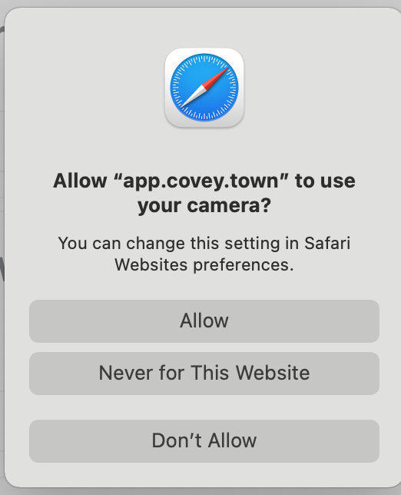
Web-Based Video Chat Apps
WebRTC, a standard for:
Capturing camera + microphone with JS
Transporting real-time audio + video between browsers
Displaying real-time audio + video with JS
Everything that does video chat in your browser without a plugin (everything now?) uses WebRTC
https://developer.mozilla.org/en-US/docs/Web/API/WebRTC_API

Slide 19
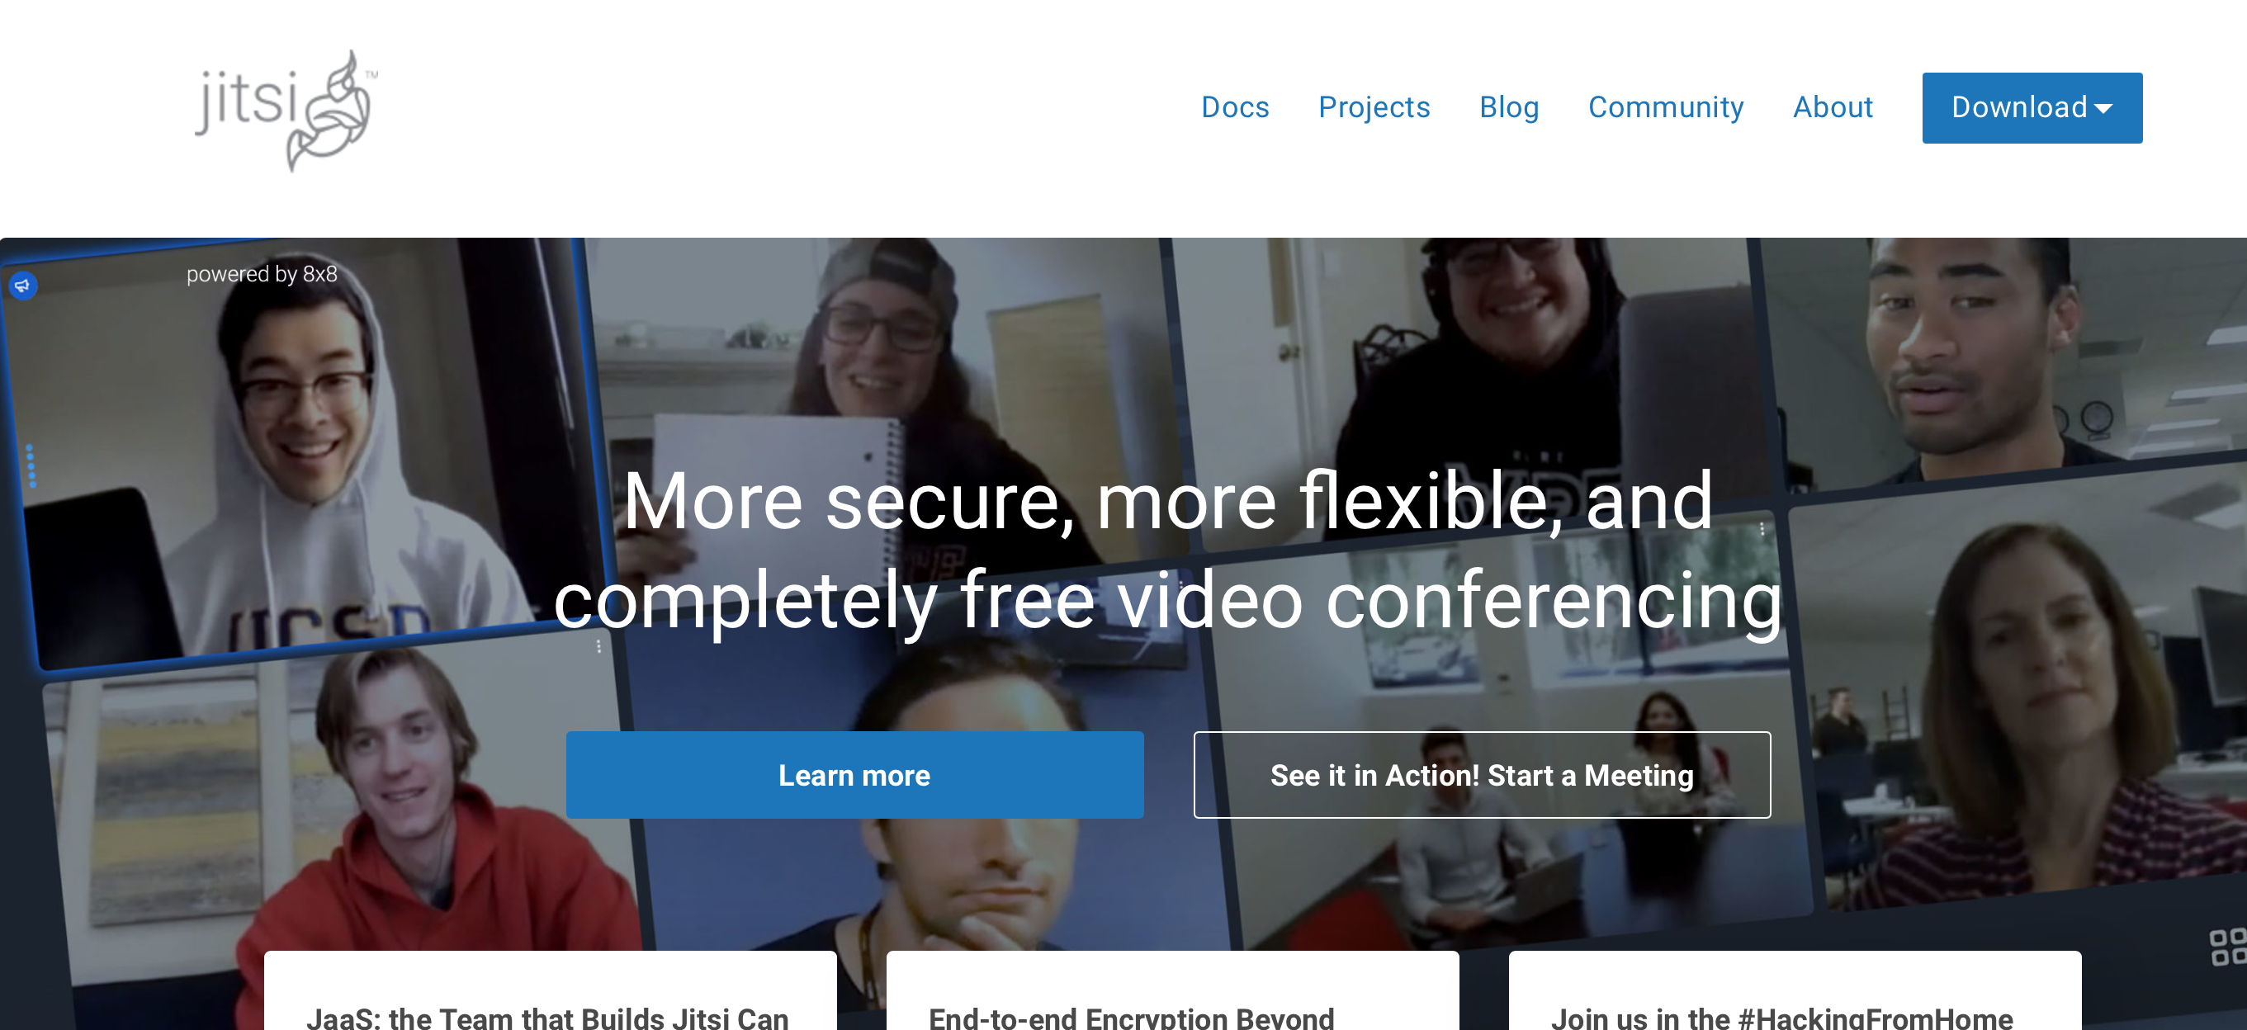
Other WebRTC services you might use
Vonage - Like Twilio, but support calls with 1000’s of participants, livestream integrations - https://www.vonage.com/
Jitsi - Open source infrastructure for WebRTC, support calls with 1000’s of participants, rich meeting UI https://jitsi.org

Slide 20
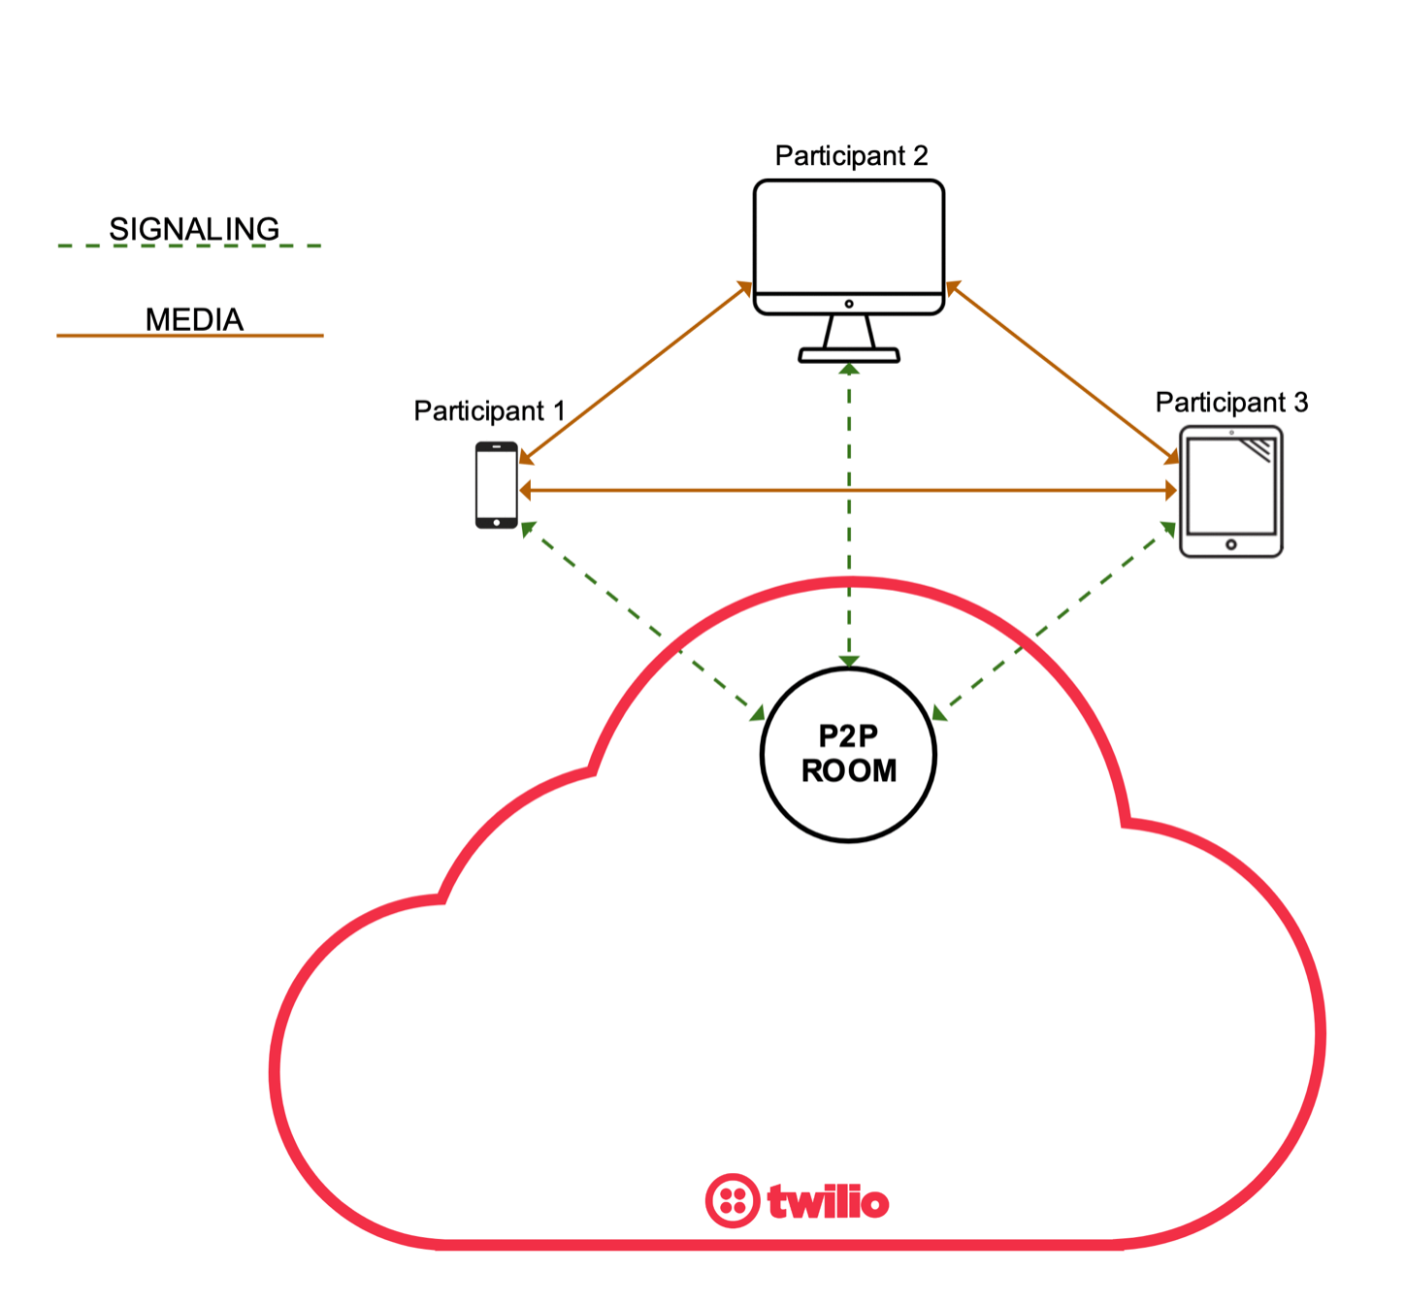
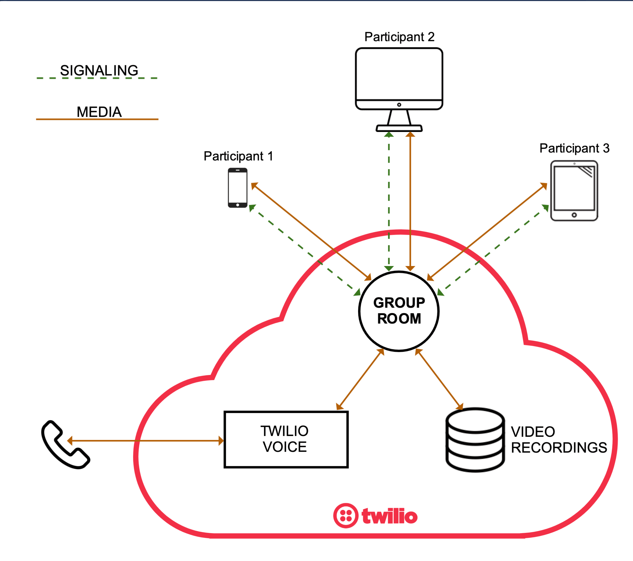
Twilio Programmable Video
Two room “topologies”: P2P + Group
https://www.twilio.com/docs/video/tutorials/understanding-video-rooms

Slide 21
Twilio Programmable Video
Publishers + Subscribers
https://www.twilio.com/docs/video/tutorials/using-bandwidth-profile-api

Slide 22
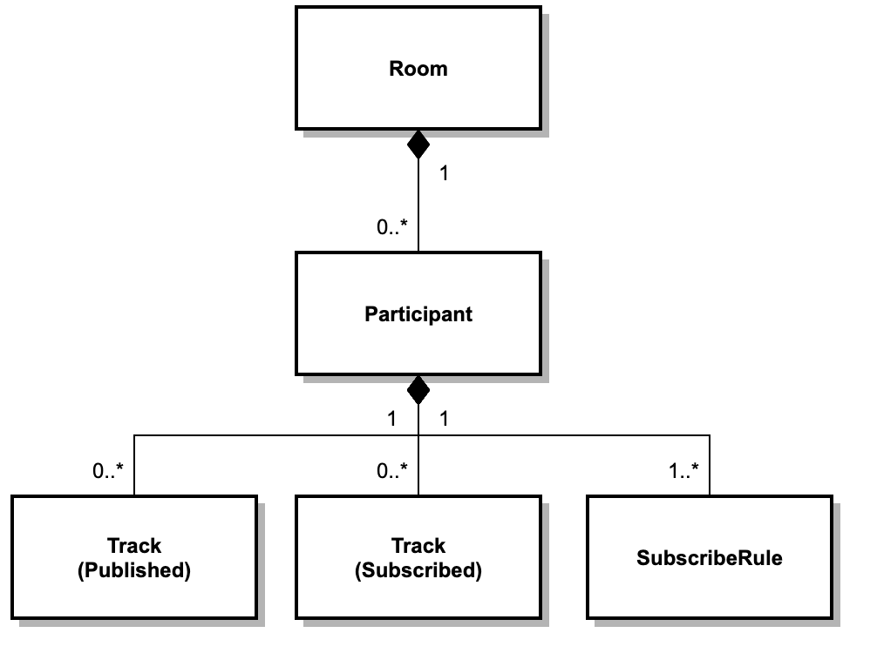
Twilio Abstractions
https://www.twilio.com/docs/video/tutorials/understanding-video-rooms-apis

Slide 23
Twilio Programmable Video
Tracks & Subscriptions
https://www.twilio.com/docs/video/api/track-subscriptions

Slide 24
This work is licensed under a Creative Commons Attribution-ShareAlike license
This work is licensed under the Creative Commons Attribution-ShareAlike 4.0 International License. To view a copy of this license, visit http://creativecommons.org/licenses/by-sa/4.0/
You are free to:
Share — copy and redistribute the material in any medium or format
Adapt — remix, transform, and build upon the material
for any purpose, even commercially.
Under the following terms:
Attribution — You must give appropriate credit, provide a link to the license, and indicate if changes were made. You may do so in any reasonable manner, but not in any way that suggests the licensor endorses you or your use.
ShareAlike — If you remix, transform, or build upon the material, you must distribute your contributions under the same license as the original.
No additional restrictions — You may not apply legal terms or technological measures that legally restrict others from doing anything the license permits.

